Slide 1
Reproducible Clinical Data Analysis with R and RStudio
Session 4
Reproducible Reports
April 5, 2018

Slide 2
Introduction | Early: 3/27, 4 PM Late: 3/27, 5:30 PM
Getting Data | Early: 3/28, 4 PM Late: 3/28, 5:30 PM
Exploring Data | Early: 4/3, 4 PM Late: 4/2, 5:30 PM
Reproducible Reports | Early: 4/5, 4 PM Late: 4/5, 5:30 PM
Course Project Presentations | TBA
Notes:
Course Project – please let me know by email or in person what you are thinking about, and we can set up a one-on-one meeting to discuss specifics.

Slide 3
R Markdown and R Notebooks

Slide 4
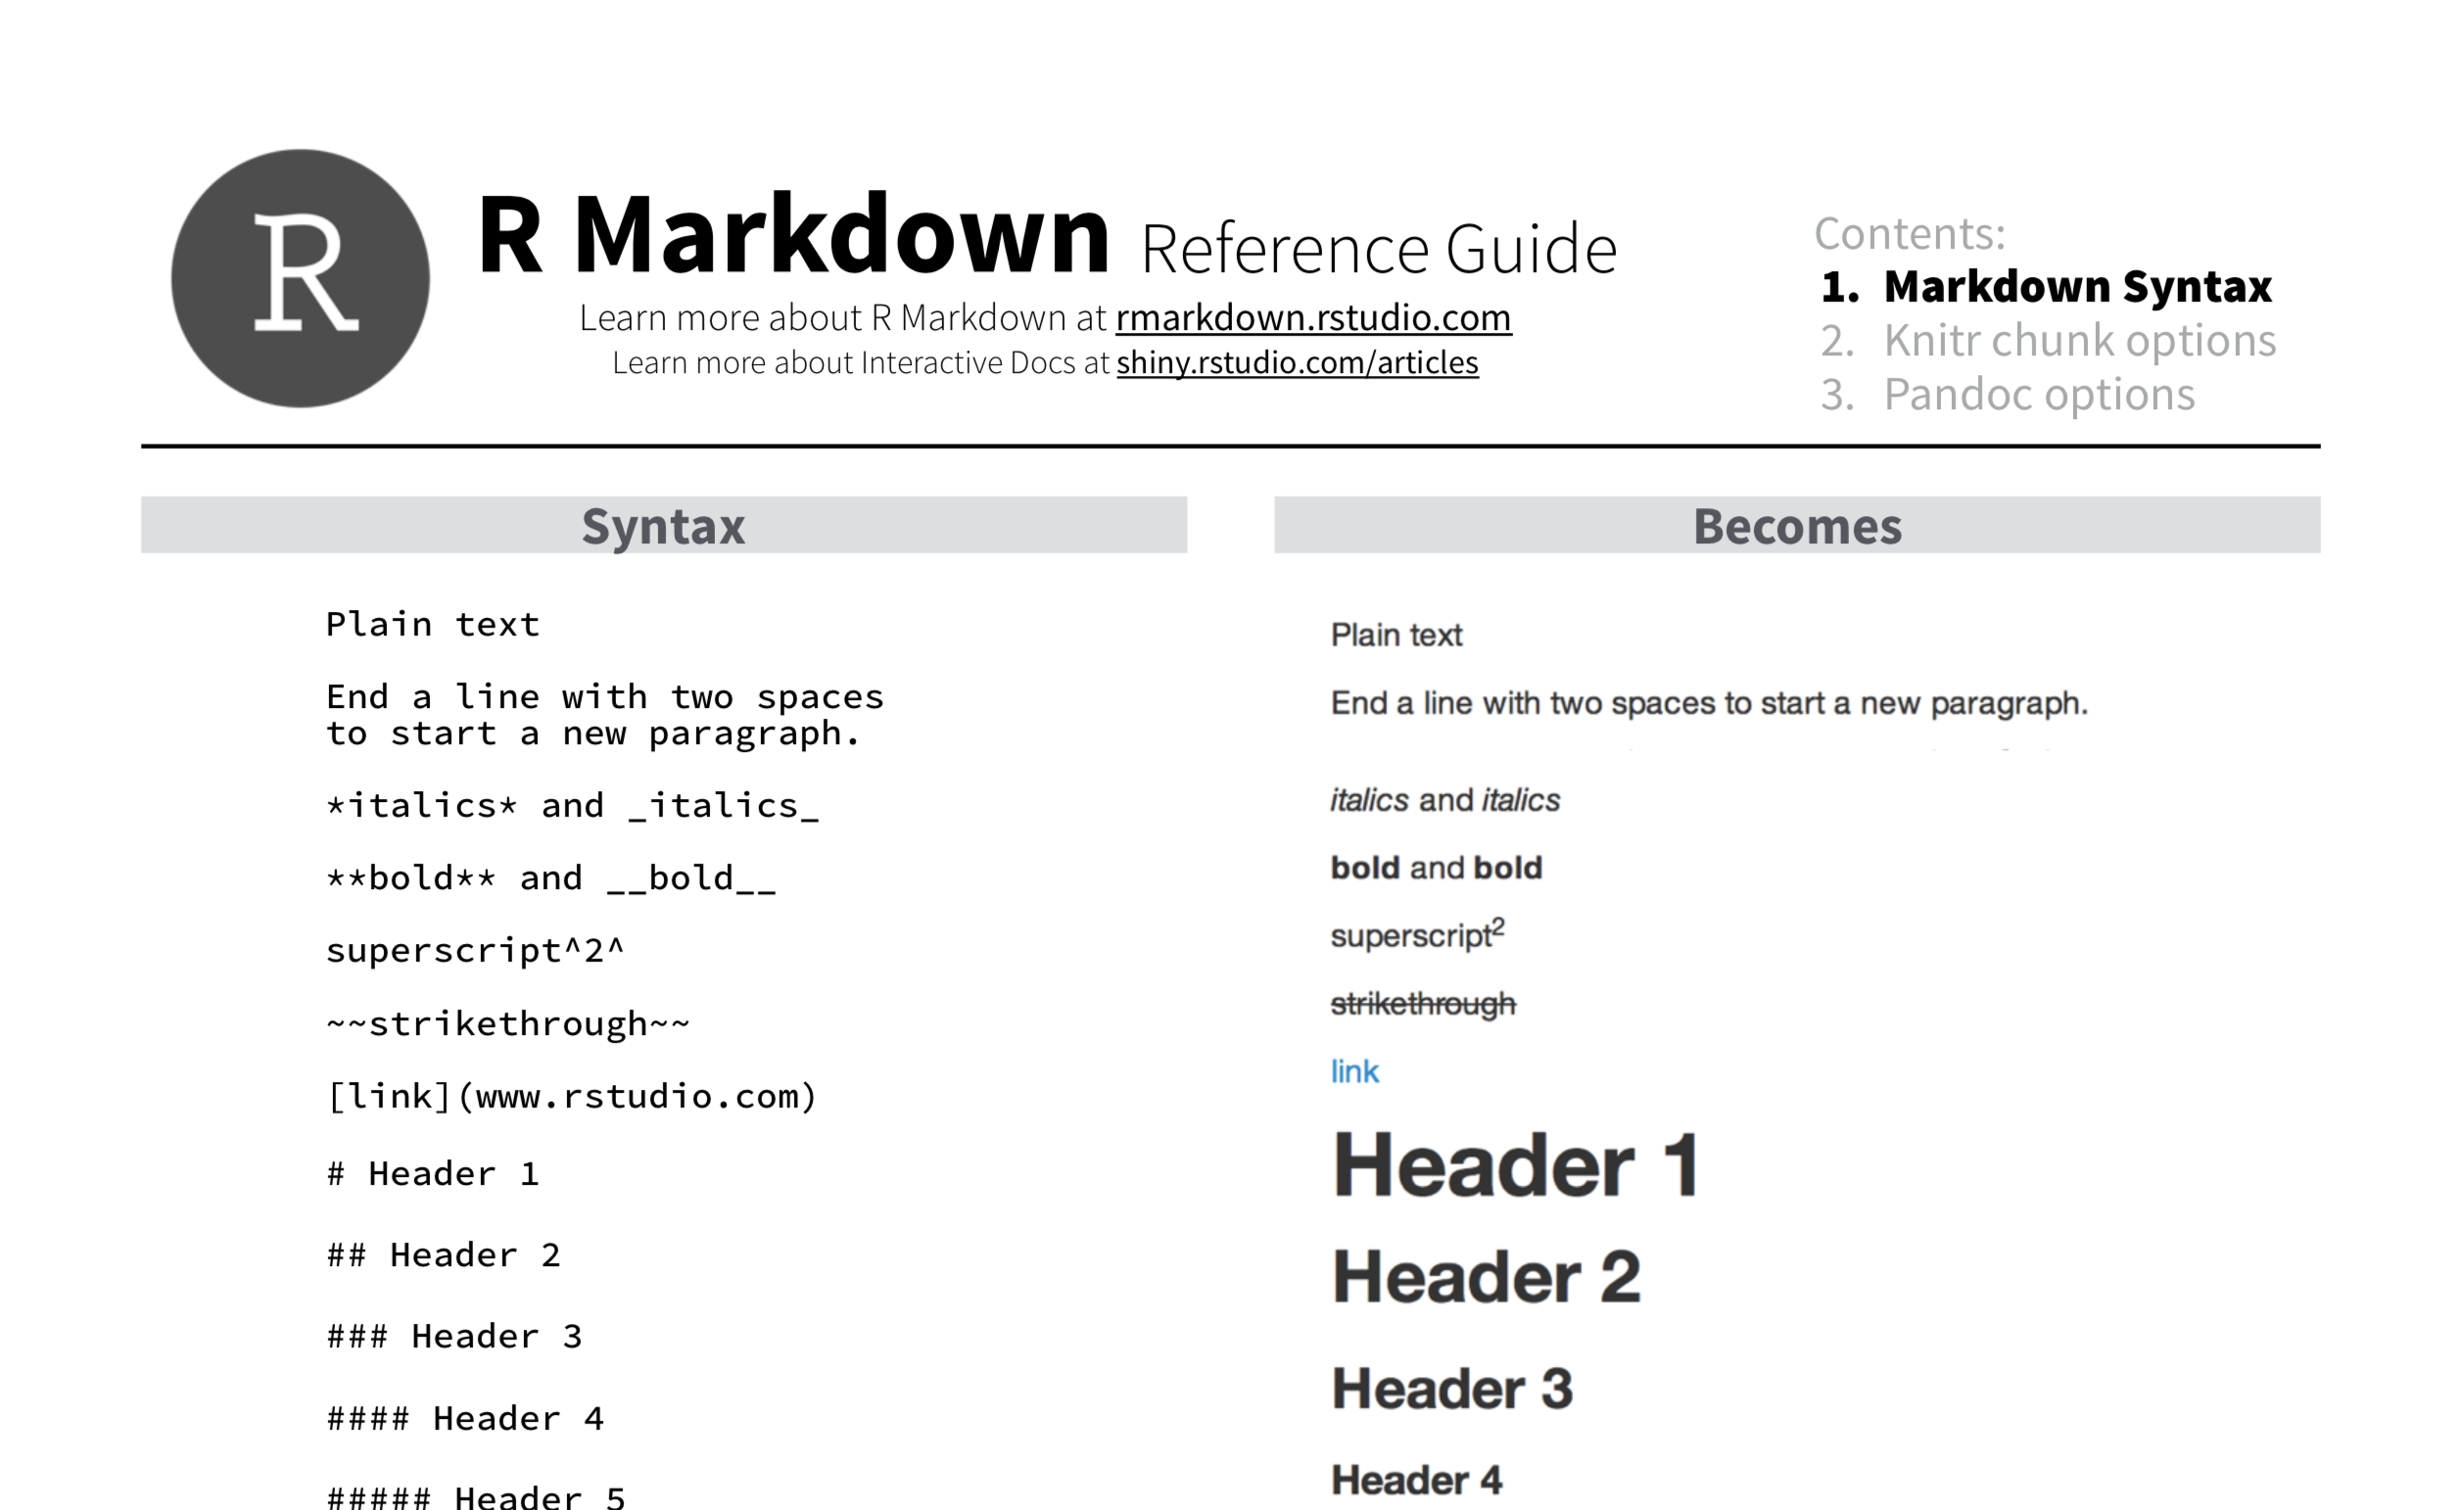
Notes:
We’ll be looking at a lot of R Markdown later, but for now, I want to point out this reference guide which is very handy for looking up how to write R Markdown. (I’ve printed out the first page which has the most useful indformation on it).

Slide 5
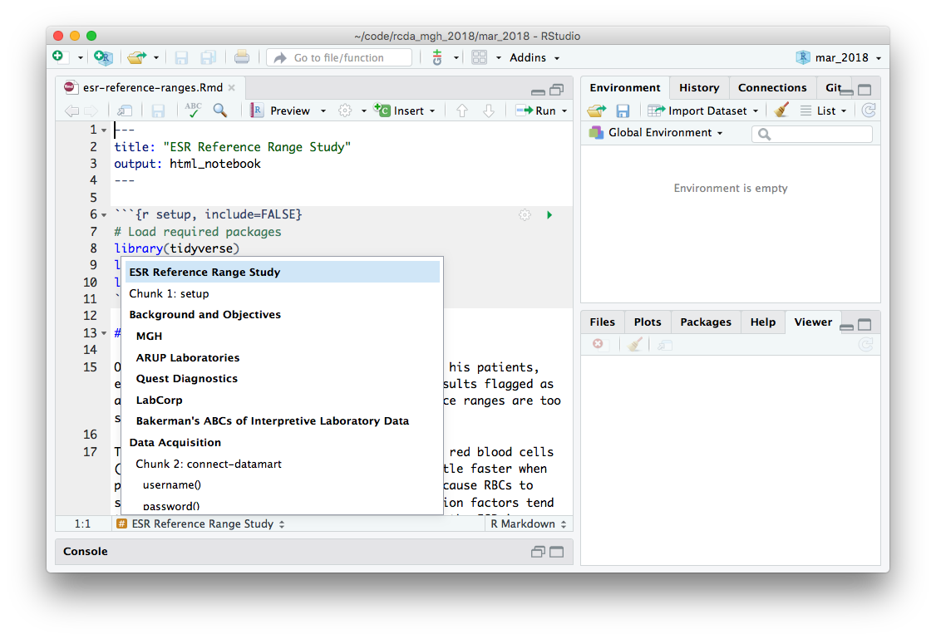

Slide 6
Demo: R Notebooks
Notes:
Create a new R Notebook
Click Preview -> save.
Show rendered document
Point out how the plot command doesn’t have the plot below it – that’s because in R Notebooks rendering the document doesn’t automatically run the code.
You usually don’t want to re-calculate an lengthy analysis each time you want to preview a small change in the document
You can preview a document even if the code is not working
.nb.html file is created and that you can share it e.g. by email

Slide 7
Your Turn #1
Create a new R Notebook. Save it on your Desktop as Practice.Rmd and preview it.
Now delete all the contents below the header and try to write the R Markdown that recapitulates the handout titled “R Notebook Practice”.

Slide 8
Anatomy of a Reproducible Report
Notes:
Now that we’ve reviewed R Notebooks, let’s a dissect esr-reference-ranges.Rmd so please go ahead and load this into Rstudio and click Preview. This should render a prelim version of the report with none of the code executed.

Slide 9
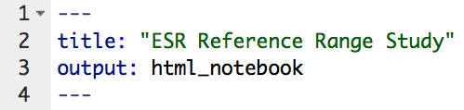
Header
title:
Document title
starts and ends with 3 dashes
output:
must say html_notebook

Slide 10

“Copy/Paste” Code
“Write Yourself” Code
Notes:
As you’re learning Reproducible Report writing, I believe it’s useful conceptually to distinguish between two types of code--
Code that does something generic – no pressing need to appreciate how it works in detail – in practice, you can copy/paste, potentially with minor modifications.
Code that is highly specific for a particular data analytic step (but may follow a general template such as the ones I discussed in the previous two sessions). You’ll want to be able to understand this kind of code in detail because a lot of this kind of code you’ll be writing yourself.
I placed these two icons in the bottom right of each slide with code to give you a sense for how deeply I believe you should try to understand the code.

Slide 11
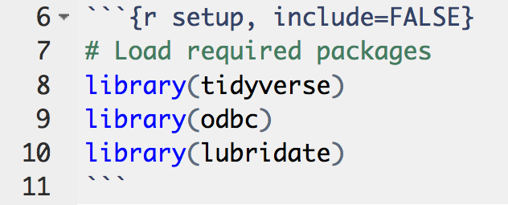
“Setup” Chunk
chunk name (optional)
chunk option:
don’t show code in rendered document
comments start with #
for database access
for dealing with dates
Notes:
All code chunks start with three backticks, and then curly braces that say r right after the opening brace. In this case, there are also two extra items
“setup” this is a label for a this code chunk, completely optional
Include = FALSE. This is a chunk option that tells R what to do with this particular chunk to render it. If you check the back of the R Markdown ref guide, you’ll see that if you set the chunk option include = FALSE R will run the code chunk but not include its code in the final document. The setup chunk is usually hidden, well, because it’s ugly.
Again, please run each code chunk as we go. Otherwise you will get errors further down below since the lower down code depends on higher up code.

Slide 12
Background and Objectives
Data Acquisition
Data Exploration and Clean-Up
Visualization and Modeling
Summary
Notes:
The purpose of the Background and Objectives section is to make sure to give enough background to yourself and others to understand the rationale behind the analysis you’re undertaking.
Be sure to include a specific objective, such as “graph all ESR values from 2017 versus patient age, broken down my patient sex”. There is no need to have all analyses thought out, but you’ll want to have a fairly good idea of what it is you want to look at first.
There are just a few details about R Markdown syntax I want to point out in this section.
(Next time, explain sections::
This is a structure for a report that’s useful and should be applicable to most clinical data projects.
Background and Objectives – it’s good to start with a hypothesis and one or two firm objectives, although often times the analysis will lead you to ask additional questions.
Data Acquisition – usually connecting to a database or importing a data file
Data Exploration and Clean-Up – Usually the data is NOT in the format you need it for visualization and modeling. Also, this is where you kick the tires and make sure that the data is as expected. This is a really important step and I can tell you from personal experience that you can lose a lot of time if you skip this.
Visualization and Modeling – this is the part where it gets interesting. Here we start to do the objectives and test our understanding of the data. This is usually several iterations of the “Understand” cycle of transforming data and creating new visualizations. This is also a great place to start involving a biostatistician who will be much more productive since you’ve already done the data cleaning and exploring.
)

Slide 13
Background and Objectives
What is the question to be addressed by the project?
How could addressing this question change patient management or further generalizable knowledge?
What data resources could be used?
What are the first 1-2 key graphs or statistics that should be obtained?

Slide 14
Background and Objectives
Data Acquisition
Data Exploration and Clean-Up
Visualization and Modeling
Summary

Slide 16
Data Acquisition
Narrative
Database sources
Database server address and database table name
Data file sources
Origin, with references
File name and format
Both
General properties of the data set
Code book for variables
Code
Database sources
Connection and query
Don’t hard-code credentials!
Data dump
Disconnect
Data file sources
Code to read data file

Slide 17
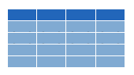
Database Tables
Database Management System
Database
PHSSQL2057
(“Datamart”)
MGHLABUTIL
MGHLABUTIL_LabResults
Notes:
Remember when we talked about databases, there’s a distinction between the DBMS, a database, and a database table.
All three are commonly referred to as “Database”.
But it’s really the database table that holds the data we’re interested in. So we need to tell R we’re interested specifically in this table, called MGHLABUTIL_LabResults.

Slide 18
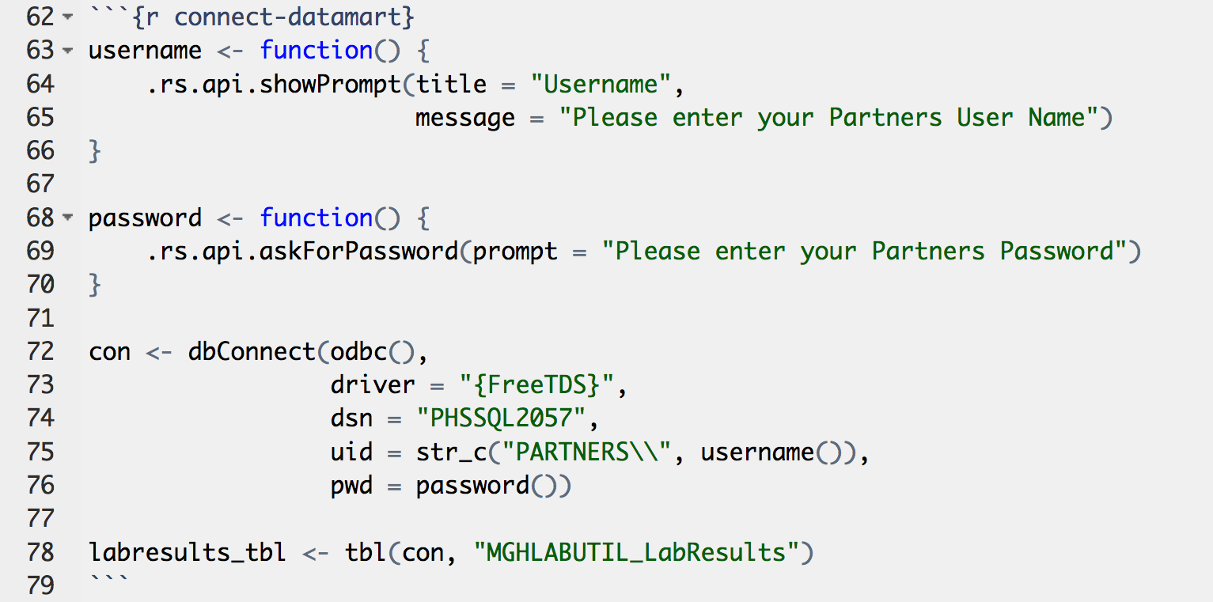
Connect to Datamart
functions to ask login credentials
pointer to database table
connection handle
Notes:
This is a prime example for a “copy/paste” type of code chunk since you will not typically ever need to modify it if you want to access the Datamart for your own project. Although some work will be involved for changing it to get accessto a different database. But once that work is done, you’ll be able to cut+paste that code.
Although I said it’s not important to fully understand how this code works, I’d like just to point out on a conceptual level what it does
Defines two functions, username() and password() that interactively ask for your username and password. This is better than hard-coding your login credentials.
The dbConnect command creates a connection handle to the database server.
The tbl command creates a pointer to the database table MGHLABUTIL_LabResults.

Slide 19

select one or more columns
Database Table
Data frame
filter rows by a condition
Notes:
Remember that in contrast to when you read a file, you usually don’t need or want to load an entire database table into R.
Instead, you select columns by their name, and you filter rows by a condition.
So at this point, it’s useful to decide which columns we want to select.

Slide 20
Your Turn #2
Connect to the Datamart by running the code chunk labeled connect-datamart.
Find the MGHLABUTIL database and within it, find the MGHLABUTIL_LabResults table.
Preview it by clicking the symbol that looks like a small table.
There are 71 columns in this database table. Pair up and discuss which specific columns you might want to pull to examine ESR reference ranges.
Notes:
This currently only works for macOS users – if you have a Windows laptop please pair up with someone with a MacBook!

Slide 21
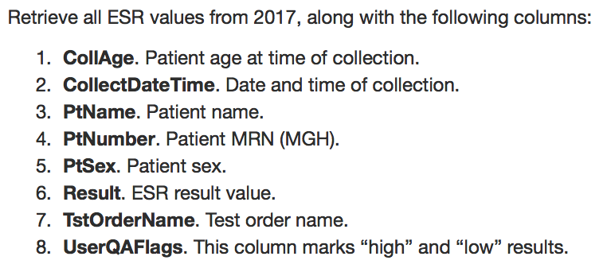
Code Book

Slide 22
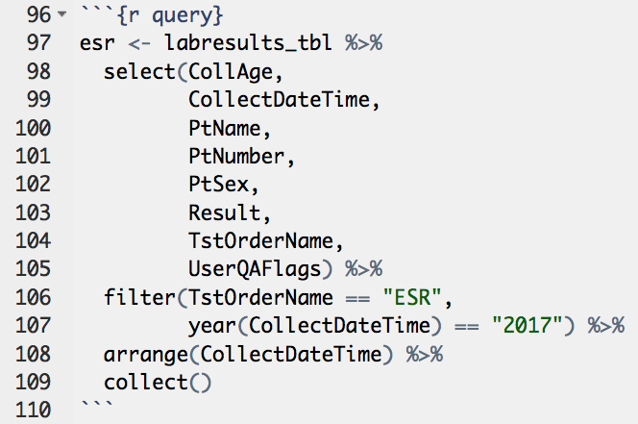
Database Query
You can treat a database table pointer like a data frame!
collect():
pull all results
(By default, max. 1000)
Notes:
Here’s something insanely cool about the tidyverse. You can treat a pointer to a remote database table as if it’s a data frame in your memory.
This is how you query a database
Select all the columns we want
Filter by TstOrderName = ESR and year of CollectDateTime == 2017
Also: sort by CollectDateTime
Collect

Slide 23
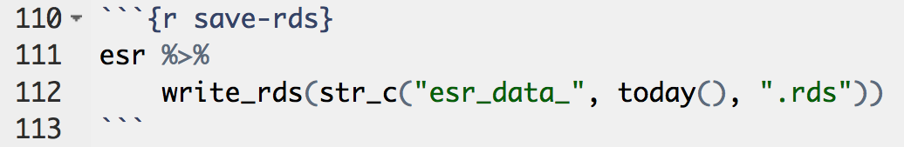

Save Data Dump
str_c(...):
join multiple strings into one string
esr_data_2018-04-05.rds
rds
Notes:
This is good to keep in case you lose access to your database for some reason.
You might want to change the filename

Slide 24
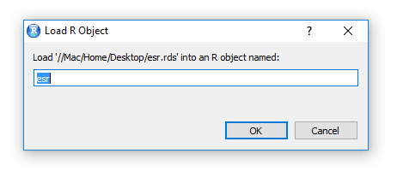
Load Data Dump (if necessary)

Slide 25
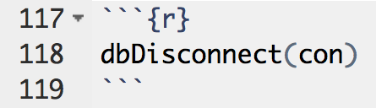
Disconnect from Database

Slide 26
Background and Objectives
Data Acquisition
Data Exploration and Clean-Up
Visualization and Modeling
Summary

Slide 28
Data Exploration and Clean-Up
Convert messy data to tidy
Check for missing values
Verify (and if necessary, convert) data types
Numeric variables should be integer or numeric
Date-time variables should be Date or POSIXct
Categorial variables should be factor
All others should be character
Visualize distributions
Numeric variables: histogram
Categorical variables: numerical summary
Character variables: look at a small sample
Is the data as expected?
Range and shape of distribution
Number and breakdown of categories
Properties of character variables
Explain and/or fix discrepancies

Slide 29
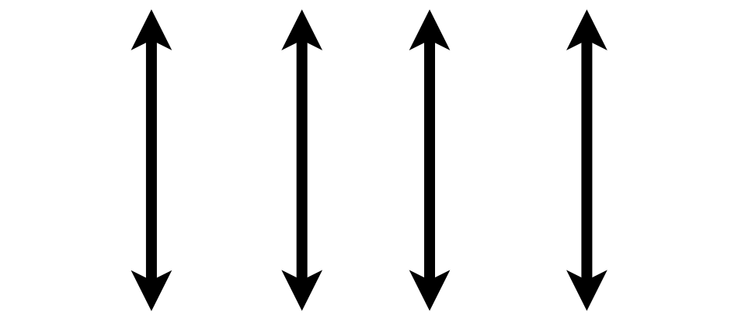

Convert Messy Data to Tidy
A data set is tidy if:
Each variable is in its own column
Each case is in its own row
Each value is in its own cell
Notes:
Review from last time: a data set is “tidy” if:
each variable is in its own column,
Each case is in its own row
Each value is in its own cell
Don’t try to analyze a data set before making it tidy first unless you know what you’re doing.
The ESR data set is tidy already. Data that come from databases often are, but not always.

Slide 30
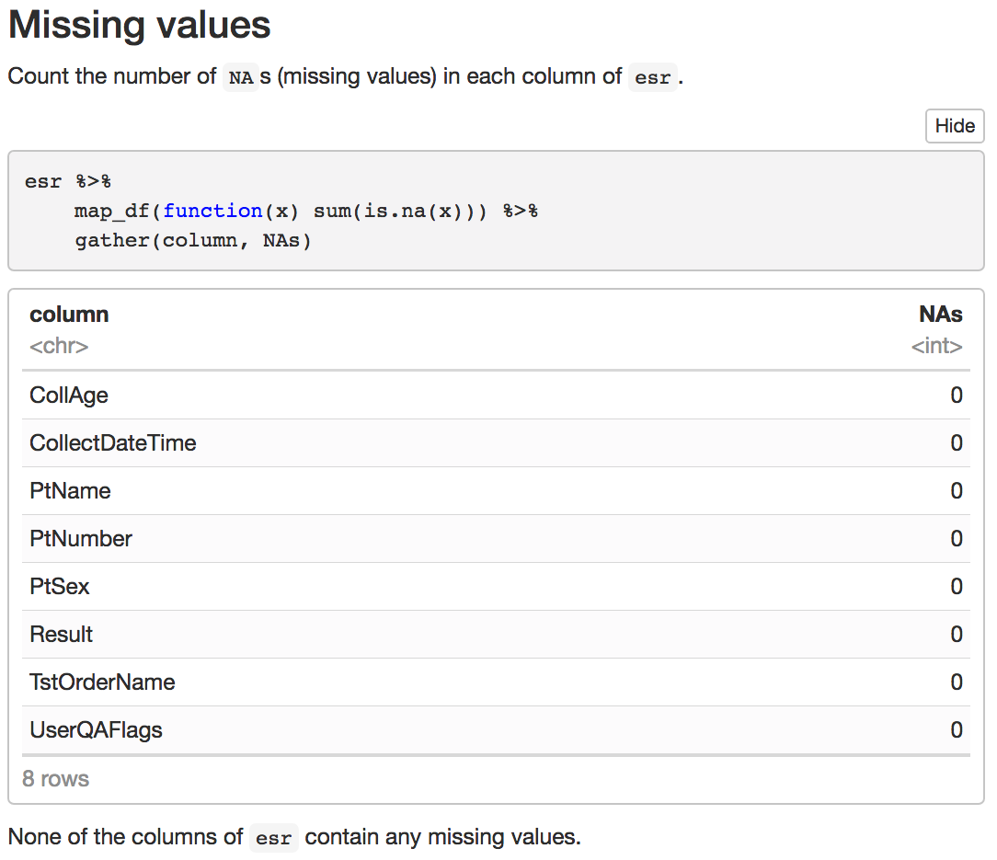
Notes:
Don’t worry about that code but be sure to include this code chunk!

Slide 31
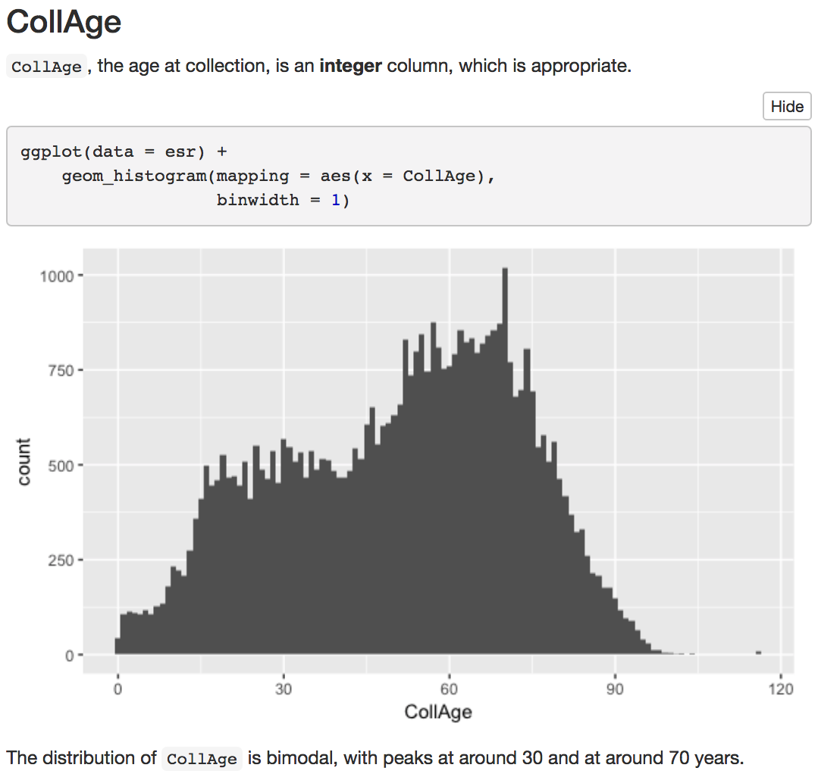
binwidth:
width of bins. Experiment!
Notes:
Add: bubbles for “Verify data type”, “Visualize the distribution”, ”Comment on the data”

Slide 32
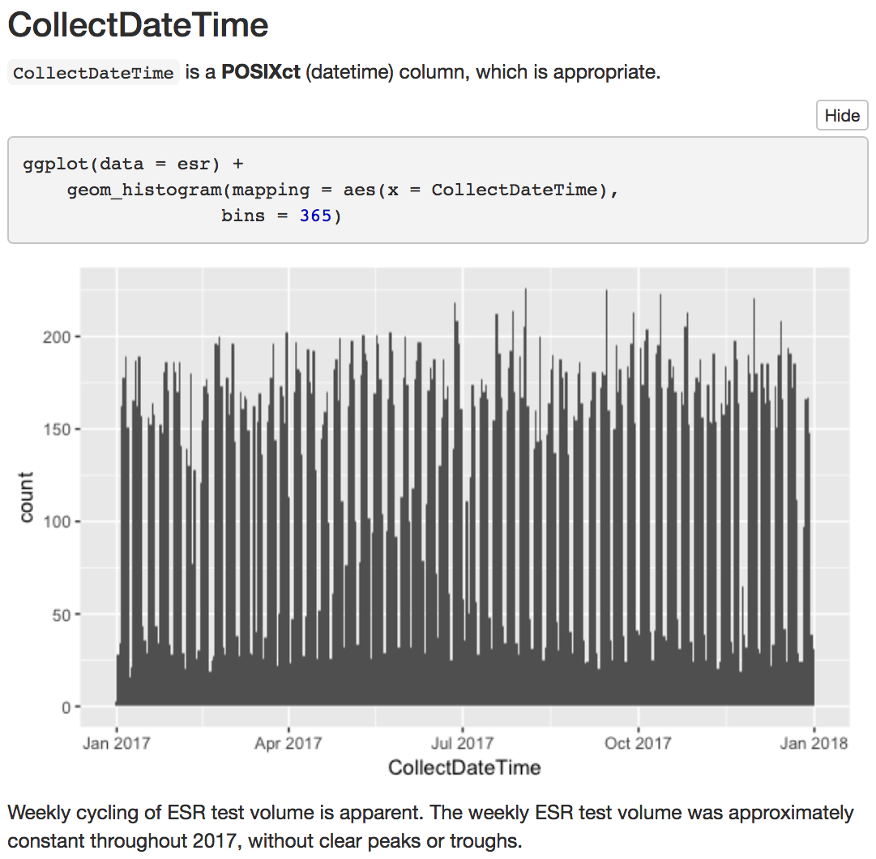
bins:
total number of bins.

Slide 33
Your Turn #3
Do you agree that weekly ESR testing volume was constant?
Can you think of an easy graph to verify this idea?
Discuss with your group and then try to create the graph in the R Markdown document.

Slide 34
set_seed():
set the random number generator
makes sure “random” results are reproducible
sample_n():
sample rows from a data frame
pull():
extract a single column and display it compactly

Slide 36
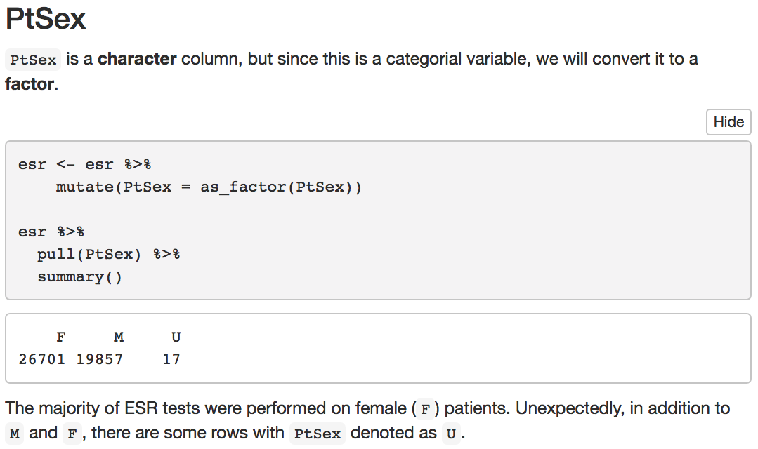
as_factor():
convert to factor
summary():
concise statistical summary
Overwrite existing PtSex variable

Slide 37
Overwrite existing esr data frame

Slide 38
Conversion of Character to Numeric Types can create Missing Values!
as.integer()
"123"
"abc"
123
NA

Slide 39
get non-numeric values of Result, arranged by order of frequency
convert Result to integer and remove all rows where Result is now NA

Slide 40
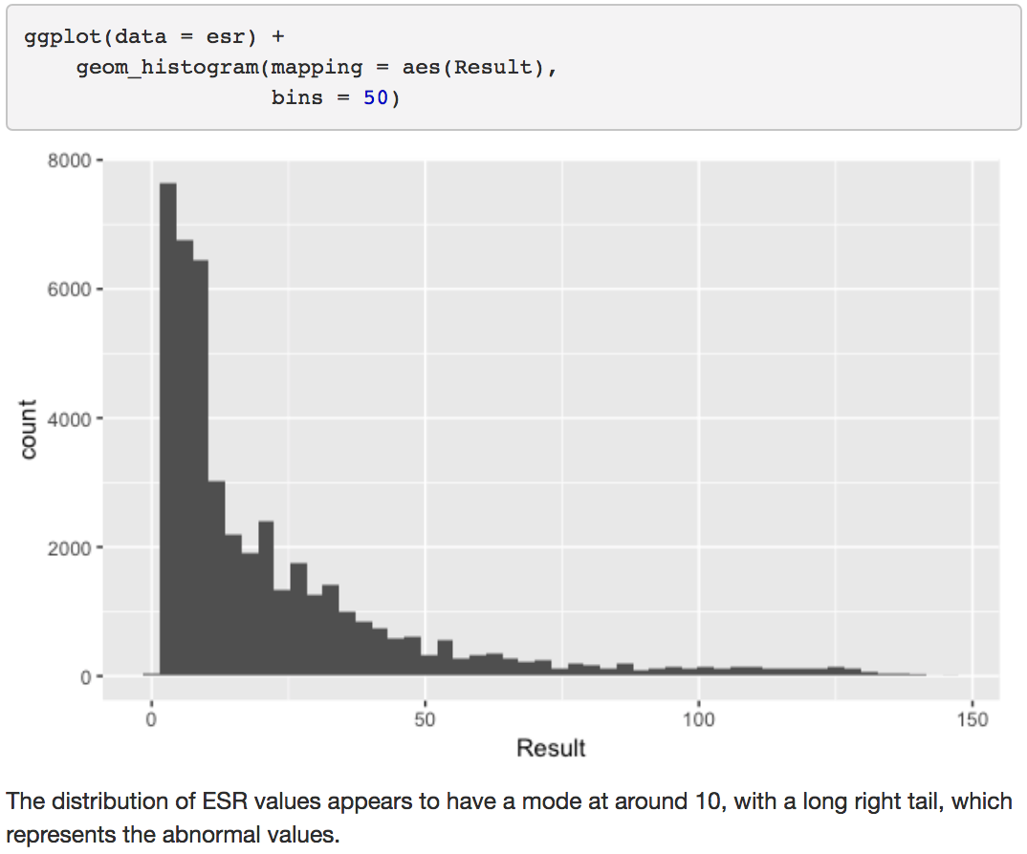

Slide 41
Background and Objectives
Data Acquisition
Data Exploration and Clean-Up
Visualization and Modeling
Summary

Slide 43
Visualization and Modeling
Iterative cycles of:
Pose a question or hypothesis.
Create a graph or statistical summary that addresses the question or tests the hypothesis.
Comment on new insights gained and new problems raised.
Notes:
Won’t actually cover code but instead, the process

Slide 44
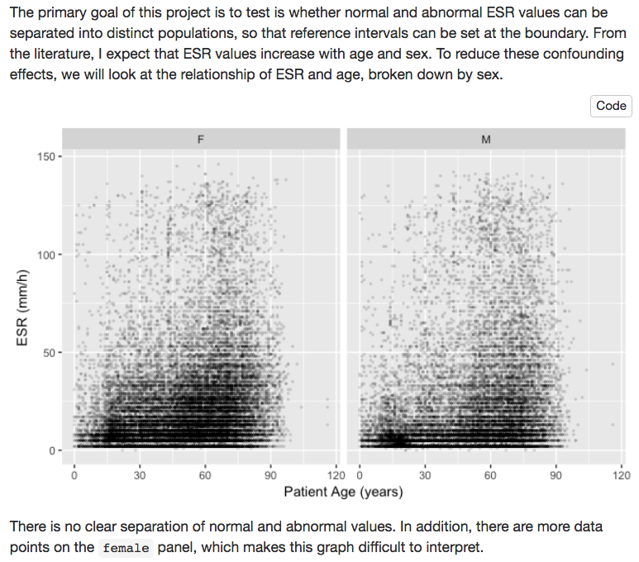

Slide 45
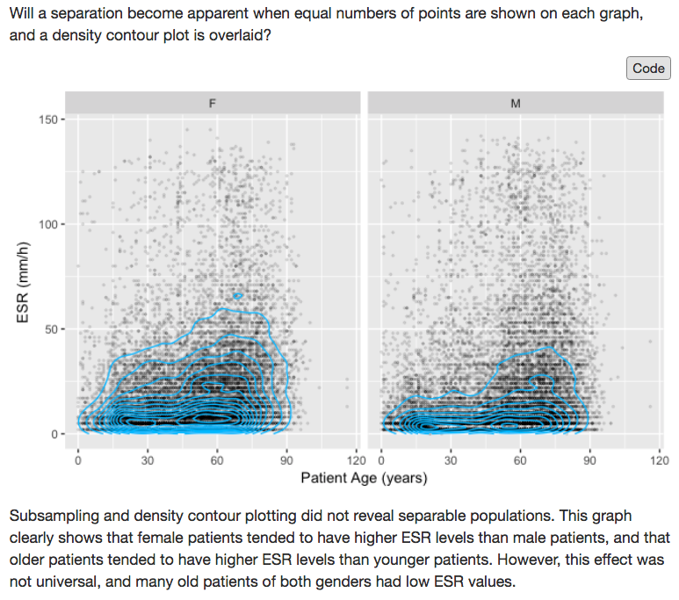
Notes:
Subsampled 15000 points from both males and females
Overlaid density contours

Slide 46
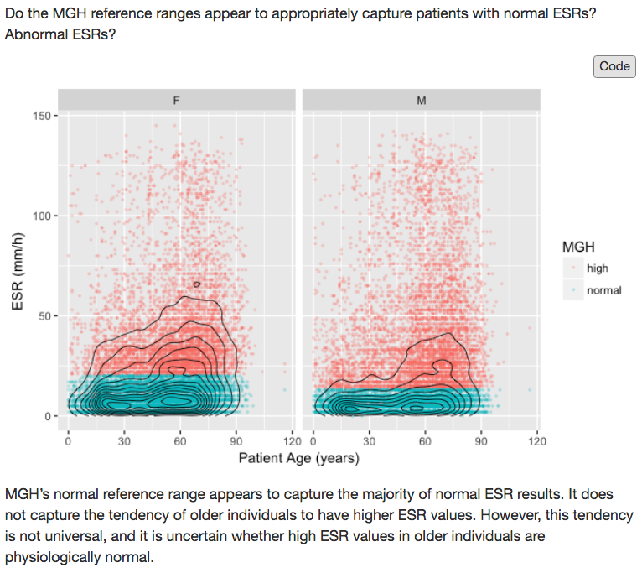

Slide 47
Background and Objectives
Data Acquisition
Data Exploration and Clean-Up
Visualization and Modeling
Summary

Slide 49
Summary
Briefly restate background, objectives, and data acquisition strategy
Restate each important result
Explain how the new insights will be used to improve patient care

Slide 50
Your Turn #4
How would you summarize the ESR report? Discuss with your group mates.

Slide 51
Notes for next time
Notes:
Remove driver=“{FreeTDS}” from Datamart connect string
In “Result”, change drop_na() -> drop_na(Result)
Replace ~~strikethrough~~ with `monospace` in Rmd tutorial

